Slide 1
E-Cigarettes and Vapes What You Need to Know
Charlie Wolff – District Security Coordinator, Retired Lieutenant, NJSP
Former Drug Recognition Expert

Slide 2
Electronic Nicotine Delivery Device
$3 Billion Global Industry
600 + Brands
8000+ Flavors & Liquids
Less than a decade ago, the e-cigarette was an obscure product marketed as a safe, tobacco-free alternative to conventional cigarettes by a single company in China

Slide 3
What Is It?
Electronic cigarette: smokeless, battery operated device used to deliver nicotine with flavorings or other chemicals to the lungs.
Vaporizer pen “vape pen”: hand-held device used to generate an inhalable vapor from a solid, semi-solid, or liquid substance.
Has the ability to vaporize THC.
Both use the same technology and are similar in appearance.

Slide 4
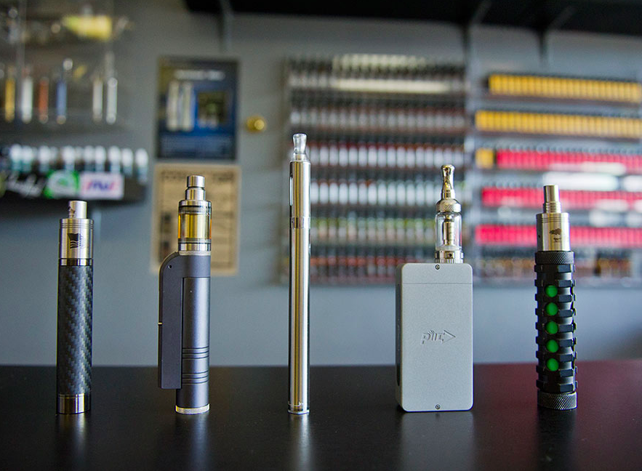

Slide 5
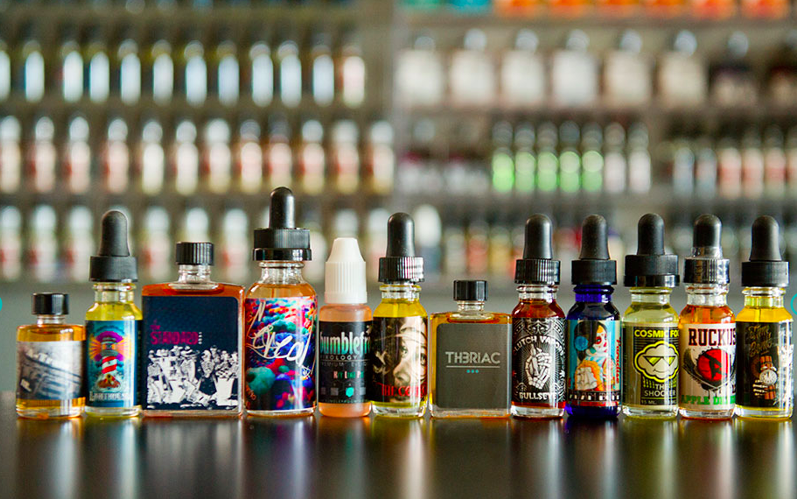

Slide 6
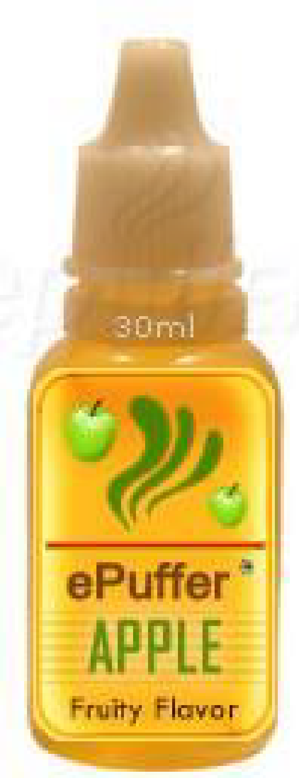
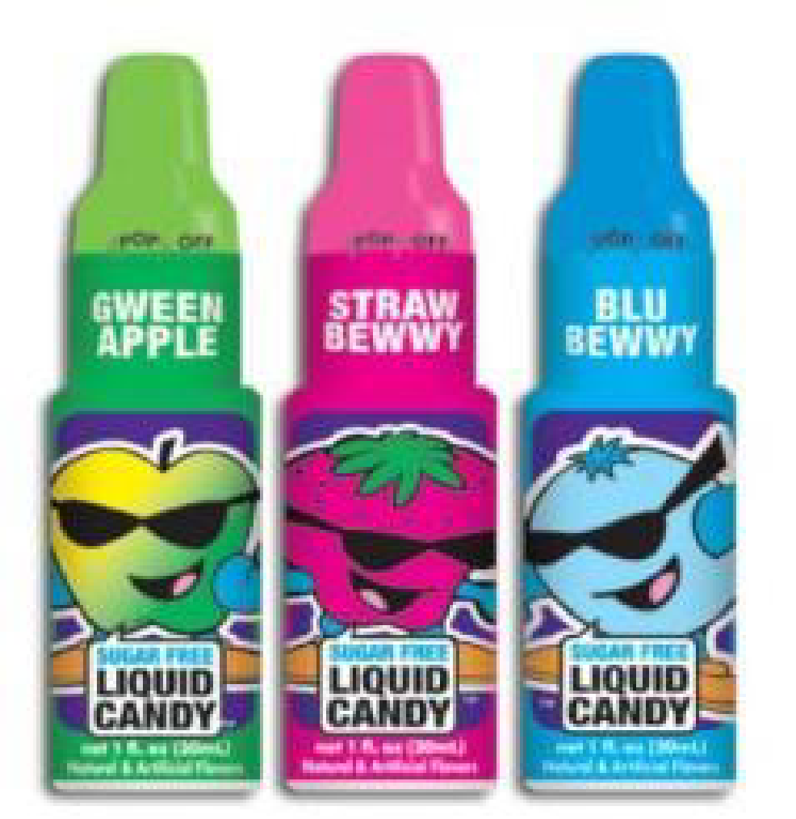
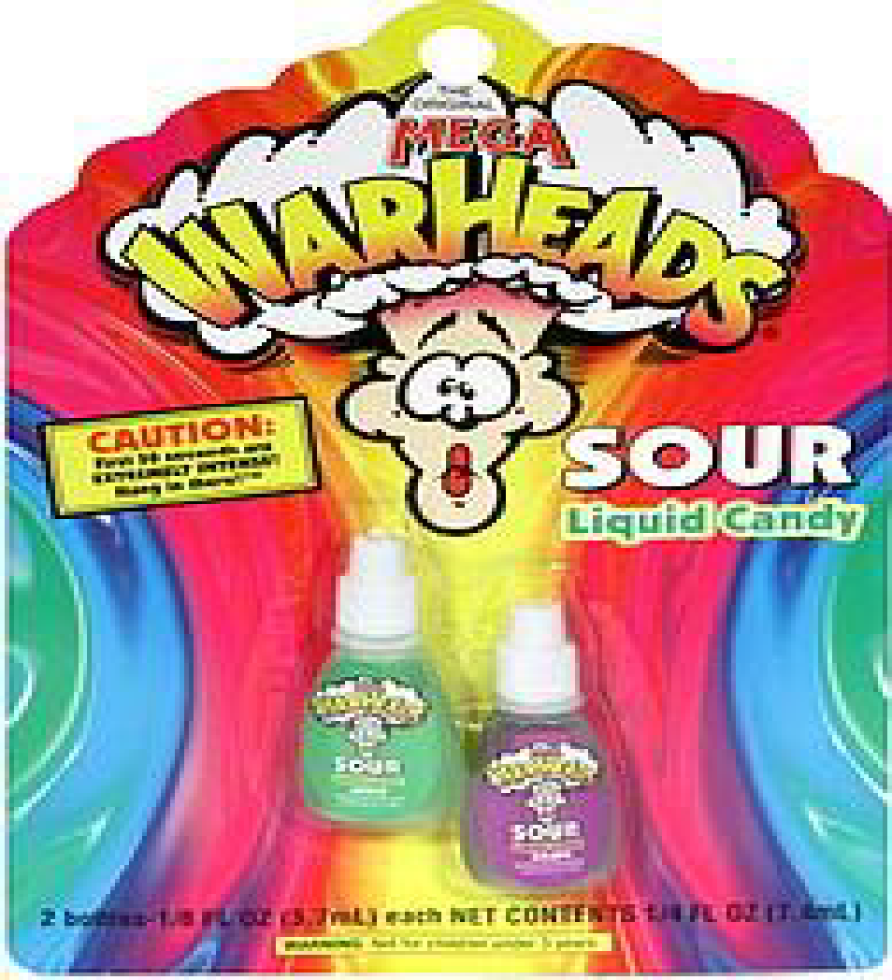
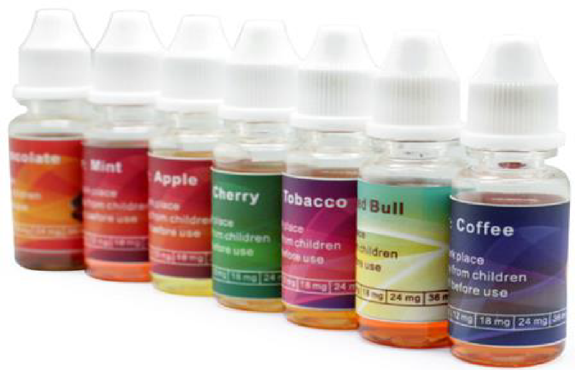
Why so many poisonings?
Can you spot the candy?

Slide 7
How Does It Work?
Usually a lithium-ion battery powers the atomizer
When a user inhales, the atomizer makes contact with the battery, activating the heating element. The liquid from the cartridge is then heated and vaporized
The liquid cartridge can contain diethylene or propylene glycol and/or vegetable glycerin, water, flavoring, nicotine, and other unknown chemicals

Slide 9
Latest and Greatest: The JUUL

Slide 10
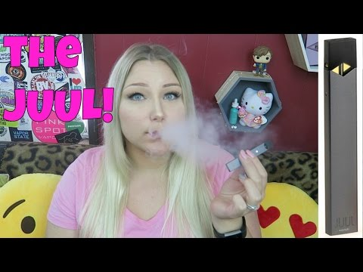

Slide 11
The JUUL is a GAME CHANGER
The primary feature of the JUUL e-cigarette is the fact that its e-liquid contains nicotine salts extracted from leaf-based tobacco
Since launching about two years ago, the JUUL has become one of the hottest e-cigarettes on the market. It's been called "the iPhone of e-cigs" and it has gained a cult following among young adults
The JUUL is a portable "nicotine-delivery device" designed to mimic the physical and sensory experience of a cigarette, without looking like one

Slide 12
JUULING
The JUUL has two components: the bottom part is the device, which includes the battery and temperature regulation system, and the top part is the e-liquid cartridge that you stick into the device
The cartridge is also the mouthpiece, so you just click it into the JUUL and you're ready to go
The JUUL device is rechargeable and comes with a USB charger that you can pop into your laptop or charging block.

Slide 13
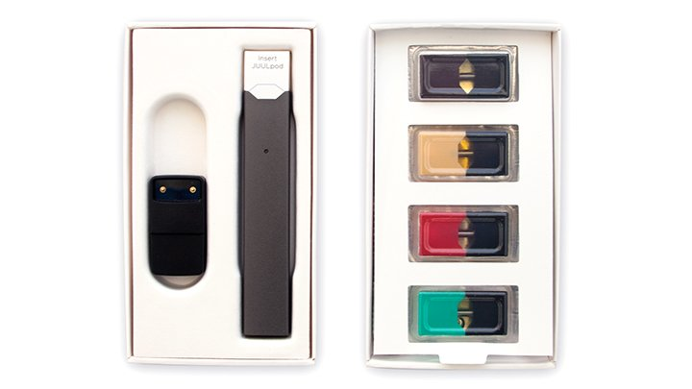
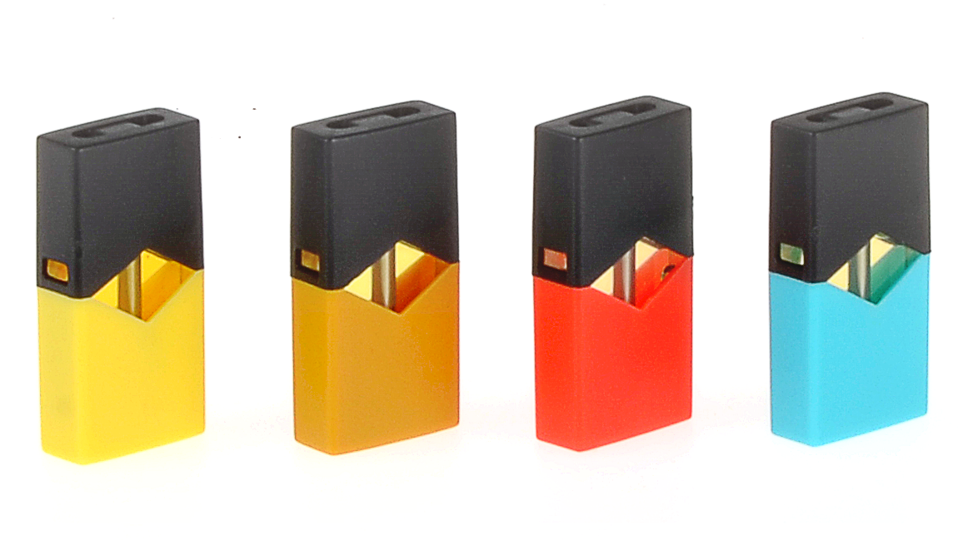
Tools of the Trade

Slide 15
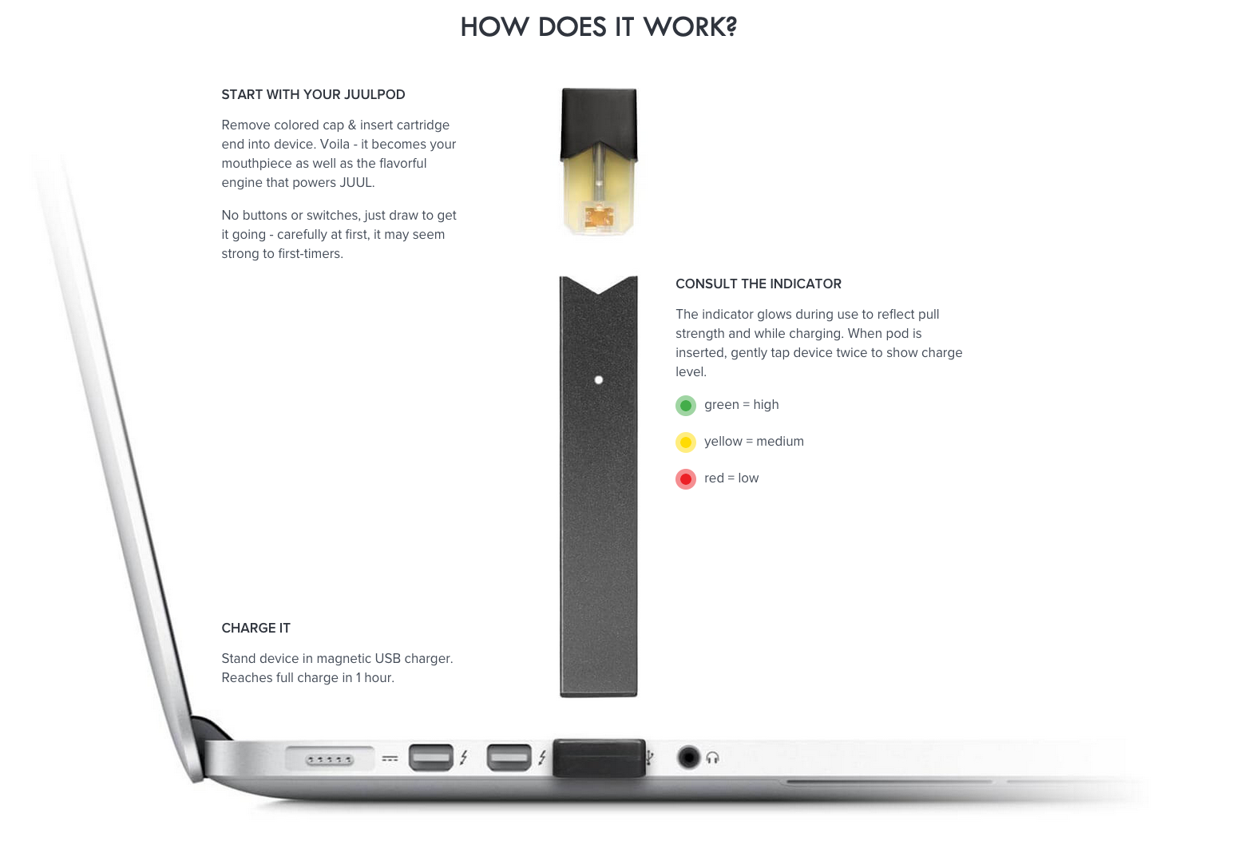

Slide 17
The FDA Warns...
E-cigarettes can increase nicotine addiction among young people and may lead kids to try other tobacco products, including conventional cigarettes, which are known to cause disease and lead to premature death.
The products may contain ingredients that are known to be toxic to humans.

Slide 18
What do we know today about what is in the vapor?
E-cigarette users exhale – passive vaping like secondhand smoke does happen.
This chemical aerosol is not “just” water vapor.
Studies so far show it contains:
Nicotine
Propylene Glycol which is converted to Propylene Oxide when heated
Formaldehyde a by-product given off during vaping and this is a chemical we use to embalm dead people. Not meant to be inhaled
Glycerin an additive in some flavored juices. Glycerin is used topically in skin care/beauty products to moisturize.
Dangers of inhaling it into the lungs are unknown at this point.
Fine and ultrafine (UF) particles
Low levels of toxins known to cause cancer
Nanoparticles of chromium, lead, nickel and tin
Volatile organic compounds (VOCs)
Notes:
Propylene glycol is FDA approved for use in some products, but inhaling propylene glycol in vaporized nicotine is not
Some studies show that heating propylene glycol changes its chemical composition, producing small amounts of propylene oxide, a known carcinogen
Fine & UF particles have been found in higher concentration than cigarette smoke
Exposure to fine & UF particles constricts arteries, triggering a heart attack
Ultrafine particles cause respiratory problems like asthma or make them worse - short term use has been shown to increase respiratory resistance and impair lung function
Nanoparticles can pass through cell walls unlike other particles
Volatile organic compounds (think gasoline) can cause cancer

Slide 19
Where is the disconnect?
NICOTINE is NICOTINE

Slide 20
Nicotine
Nicotine is a highly addictive substance — and each hit of the JUUL packs quite the nicotine punch. The nicotine content is 0.7mL (or 59 mg/mL) per pod, which is approximately equivalent to one pack of cigarettes, or 200 puffs
The JUUL is portable, easy to use, and delivers a cigarette-strength dose of nicotine — which makes it an attractive alternative.
The JUUL also produces minimal byproduct, so you don't blow out an obnoxious cloud of smelly smoke or vapor. This also makes it easier to use inside, although many places such as bars and restaurants have banned e-cigarettes and vapes

Slide 21
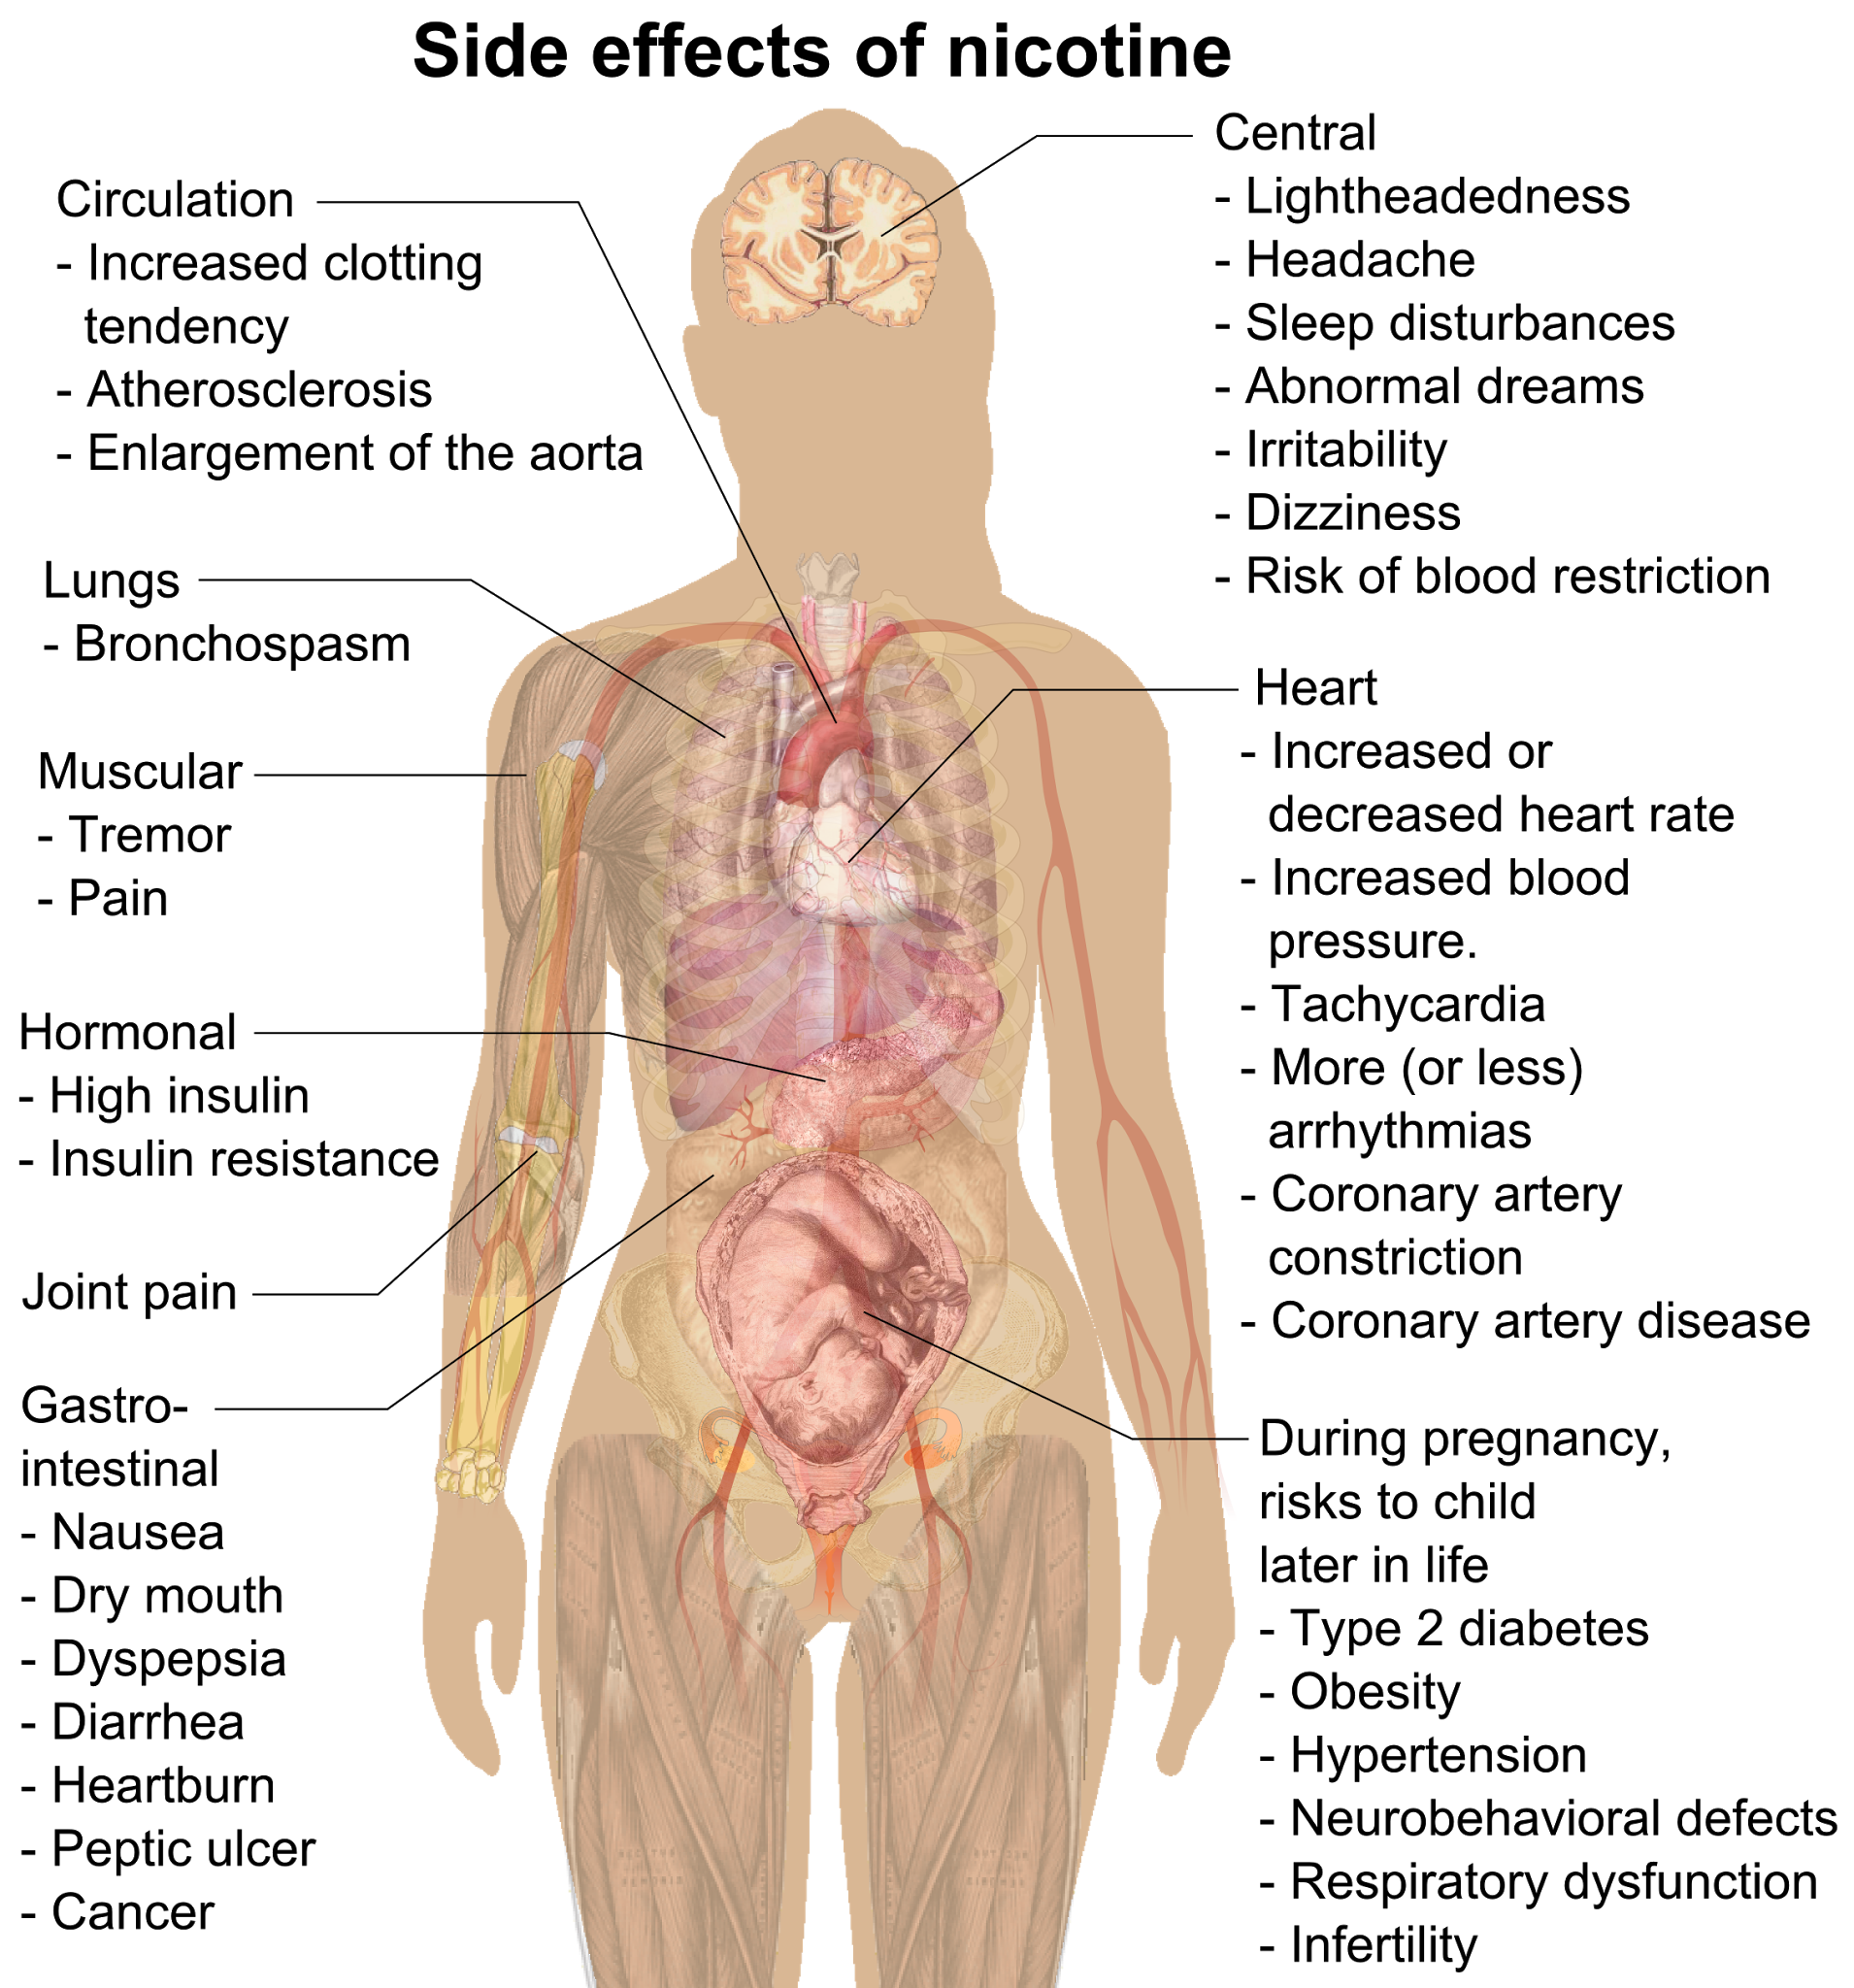
Side Effects of
Nicotine

Slide 22
Nicotine = POISON
Large amounts of nicotine are lethal (60 mg adult, 6mg children)
Nicotine an insecticide and toxicant
The number of poisoning cases linked to e-cigarettes liquids was 1,351 in 2013, a 300% increase from 2012

Slide 23
DANGER AHEAD
The JUUL may be safer than regular cigarettes, but no e-cigarette is considered "safe" — and it's never just vapor that you're inhaling
According to their website, "no tobacco or e-liquid product should ever be considered 'safe' [and] we encourage consumers to do their own research regarding vapor products and what is right for them."
Users are inhaling a lot of chemicals, especially if the vapor has flavoring agents. Although there aren't many acute health effects of inhaling e-cigarettes, they can exacerbate asthma and other lung conditions

Slide 24
Health Effects
A study examining the biological effects of e-cigarettes found “strikingly similar” gene mutations in lung cells exposed to e-cig vapor as those found in smokers.
This means that although e-cigarette vapor is tobacco and tar-free and that the device does not require combustion, it could potentially increase a user’s risk of cancer.
Nicotine can act as a neurotoxin and alter brain chemistry, so the brain doesn't function normally without it.
Nicotine is very dangerous for kids and teenagers, because their brain is still developing

Slide 25
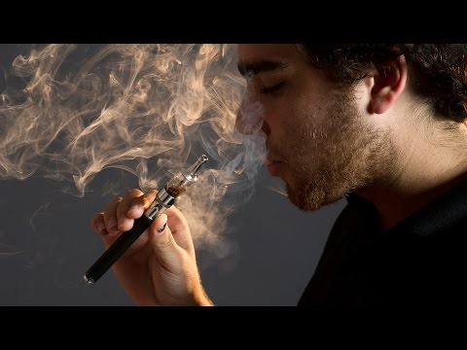

Slide 26
BIG LIES BY BIG TOBACCO
E-Cigarettes have only used widely since 2007
Most people have heard little about the risks
In actuality, we are all at risk for being lied to by Big Tobacco with their massive Pro-Vaping Campaign.
Guess What?
Big Tobacco owns the largest E-Cigarette Companies and are aggressively marketing their new product as SAFE!

Slide 27
Are E-Cigarettes a Safe Alternative?
That’s what Big Tobacco wants you to think
Aggressive marketing to teens
Teen usage of vaping tripled between 2013-2014
Experts warn nicotine may harm the developing teen brain
Pregnant women may believe it is safe alternative to vape due to the misconception that it is only vapor

Slide 28
“Gateway Drug”
Increased risk of addiction to cocaine and other drugs
Nicotine greatly enhanced the effect of cocaine in mice
Cocaine dependence greater in heavy smokers (>100 cigarettes before using cocaine)
Nicotine acts as a gateway drug with the effects of addiction, especially in adolescents

Slide 30
Teens Love Vaping for ALL These Reasons
Teens think it is “Fun & Cool”
Sharing vaping stories on Snapchat, YouTube & Instagram
On these sites: popularizing tricks such as blowing an “O” or exhaling via nose
Some vape pens look like actual pens, and are undetected (Cloud 2.0 & MicroG)
Easy to conceal/ use in school

Slide 31
RIHRHSD Substance Abuse Policy/Regulation
Suspected of being under the influence
Medical Examination/Diagnostic Screen
Suspensions Vary-up to 10 days
Must be cleared to return
Your Health and Safety is our main concern

Slide 32
We Are Here to Help Now!
Counselor
Student Assistance Counselor - Mr. Kohlbrenner/Mr. Kersting
Counseling and Education
Meditation
Be involved and use RHS Activities
Total Family Involvement
Other

Slide 33
WHERE DO YOU GO TO GET HELP?
COME TO US - OUR STUDENT ASSISTANCE COORDINATORS CAN HELP YOUR CHILD IF THEY ARE STRUGGLING WITH ANY FORM OF NICOTINE USE, WHETHER THEY FEEL ADDICTED OR ARE SIMPLY STUCK IN A CYCLE OF PEER PRESSURE
SMOKEFREE.GOV
TEENSMOKEFREE.GOV

Slide 34
A Special Thanks to Franklin Lakes Municipal Alliance & Liz Morris

